Slide 1
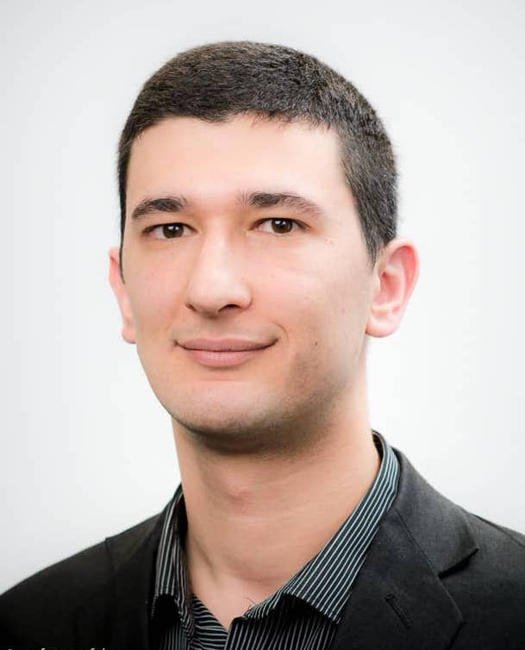
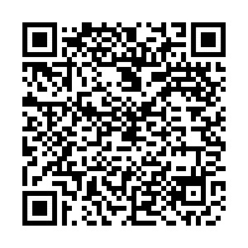
Mainz Immunology Seminar Series
Dr. rer. nat. Hristo Todorov
University Medical Center Mainz Institute for Human Genetics “The inactive X-chromosome: a female reservoir of resilience?”
When?: Tuesday, 19.12. 2023 at 12:00 pm s.t.
Where?: PKZI Building 308A, Room 3.105
Organized by: Research Center for Immunotherapy (FZI), CRC TR355, CRC 1292, UCT, EMTHERA
Contact: Doreen Nothmann & Nadine Hövelmeyer, Research Center for Immunotherapy (FZI), University Medical Center Mainz, nothmann@uni-mainz.de, www.fzi.uni-mainz.de, phone: 06131-178114
Calendar Mainz Seminars:

